Slide 1
Supernormal stimuli, W&C and RI
Mihai Toma
Camerer lab meeting

Slide 2
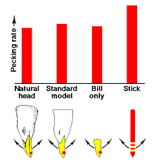
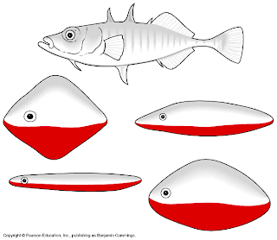
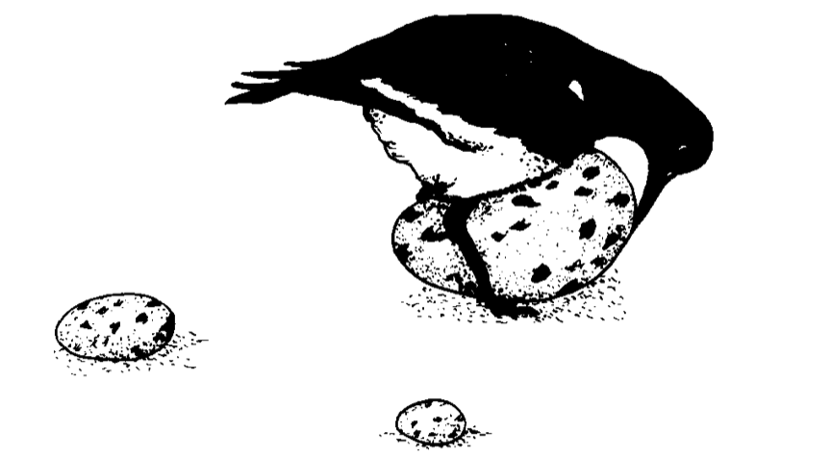
Supernormal stimuli and peak-shift effect
Exaggerated responses to existing stimuli
Evolutionary adaptation
Oystercatcher
Stickleback fish
Herring gull
Tinbergen, 1949; Tinbergen & Perdeck 1950; Tinbergen, 1989

Slide 3
SNS in humans
Sex
Food
Danger → initial piloting with animals
Television and social media
Evolutionary mismatch → we are able to bypass natural instincts using cognitive overrides, but weaknesses can be exploited using technology
→ Warmth and competence as SNS to generate peak-shift

Slide 4
Warmth and competence
Cuddy et al. (2008) Stereotype Content Model (W&C) and the BIAS Map
Fiske et al. (2007) Universal dimensions of social cognition: warmth and competence
Fiske (2017) Stereotype Content: Warmth and Competence Endure
Wang et al. (2017) Effects of Smile Intensity on Perceptions of Warmth and Competence
Bennett et al. (2019) The impact of perceptions of politician brand warmth and competence on voting intentions
De Boer (2020) Street-Level Bureaucrats’ Warmth and Competence
Rudert et al. (2017) W&C on moral judgments of social exclusion
Chujun et al. (2022) Mental state impressions from faces
Notes:
Cuddy et al (2008):
Fiske et al. (2007): People perceived as warm and competent elicit uniformly positive emotions and behavior, whereas those perceived as lacking warmth and competence elicit uniform negativity. People classified as high on one dimension and low on the other elicit predictable, ambivalent affective and behavioral reactions. These universal dimensions explain both interpersonal and intergroup social cognition.
Walker and Vetter (2016): Thus, the two dimensions communion (or trustworthiness/ warmth) and agency (or dominance/competence) seem to be especially important when characterizing individuals or social groups.

Slide 5
Face modelling and databases
Blanz and Vetter (1999) A morphable model for the synthesis of 3D faces
Todorov et al. (2008) and Todorov and Oh (2017) Trust and dominance
Langner et al. (2010) Radboud faces database
Walker et al. (2018) Basel face database
Vetter et al. (2019) Basel Morphable Face Models - An Open Framework

Slide 6
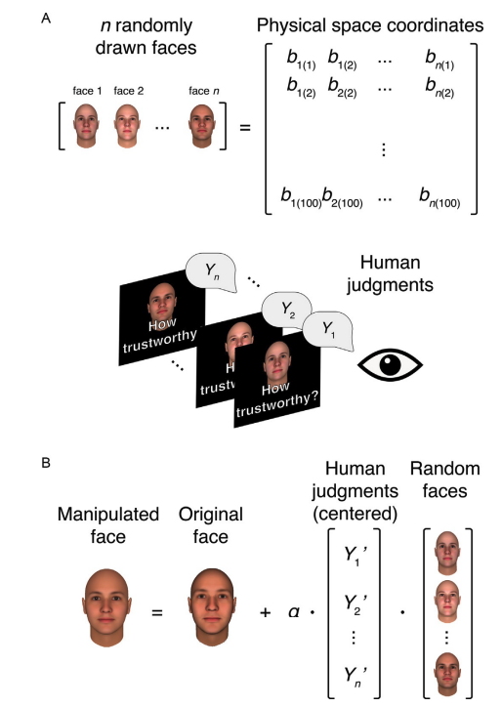
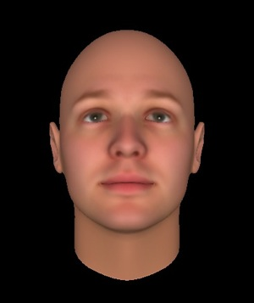
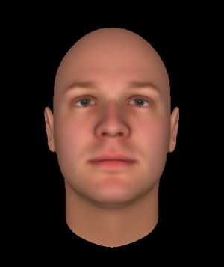
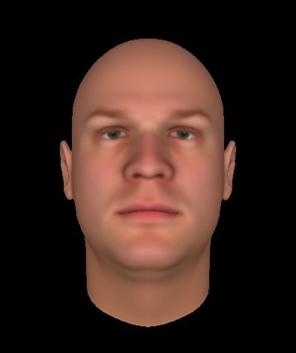
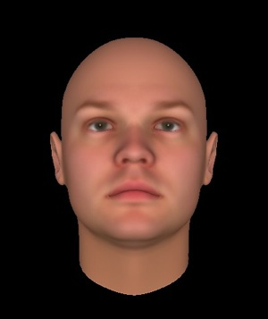
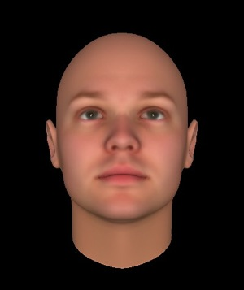
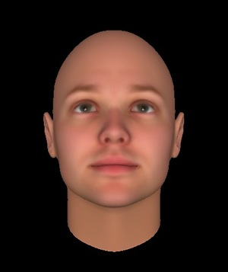
Todorov et al. (2008)
Dominance
Trustworthiness
-8 SD
0 SD
8 SD

Slide 7
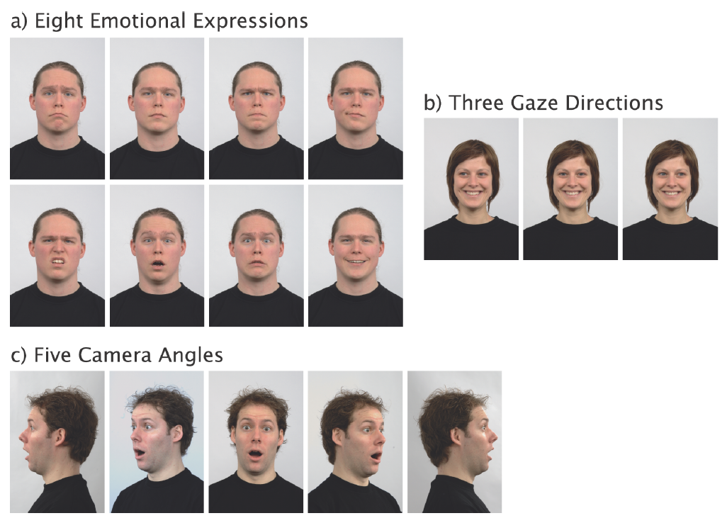
Langner et al. (2010) – Radboud faces database
49 models, adults and children
276 students rated – each validated 9 models
1-5 scale:
Attractiveness
Expression
Intensity
Clarity
Genuineness
Valence

Slide 8
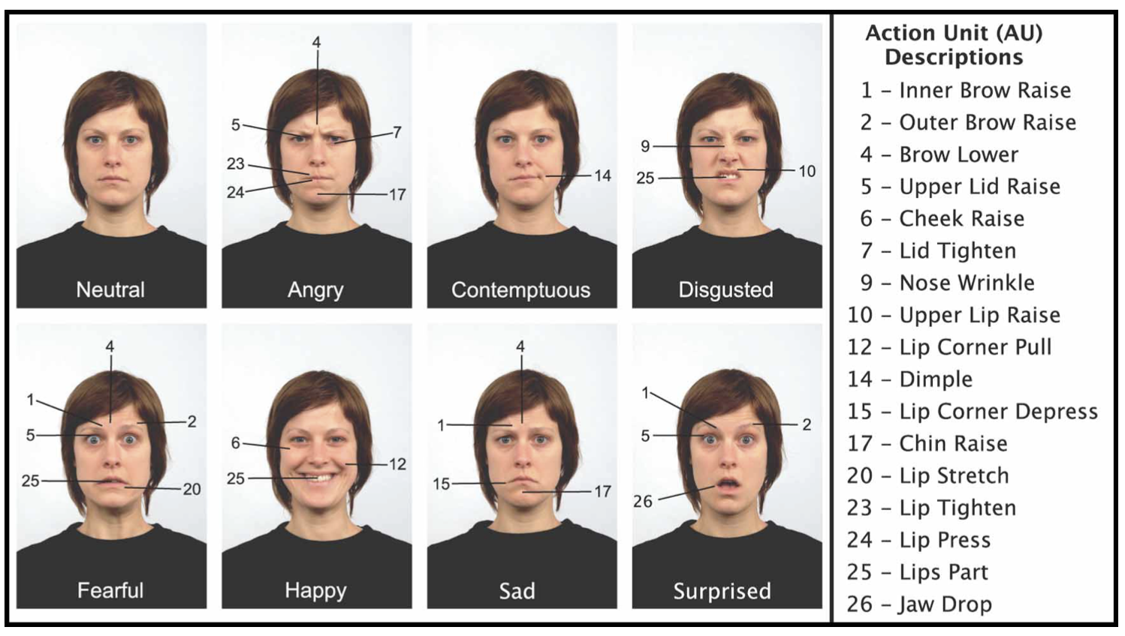
Langner et al. (2010) – Radboud faces database

Slide 9
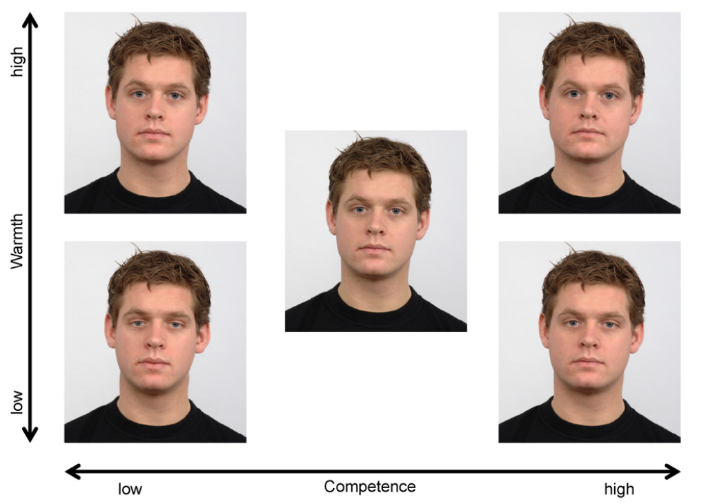
Rudert et al. (2017)

Slide 10
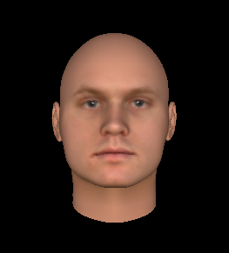
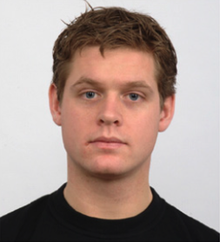
FaceGen 3D modeler
Warmth
Competence

Slide 11
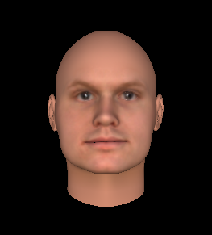
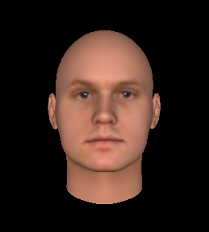
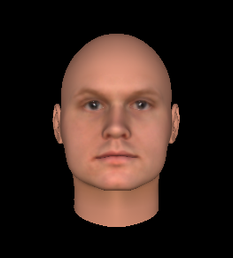
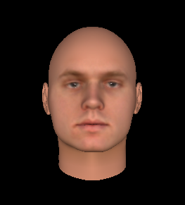
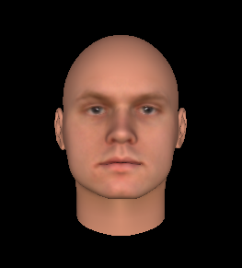

Morphing expressions
High
Warmth
Low
Low
Competence
High

Slide 12



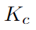
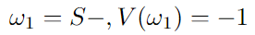
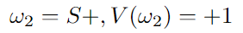
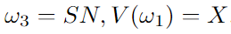
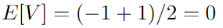
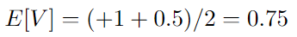
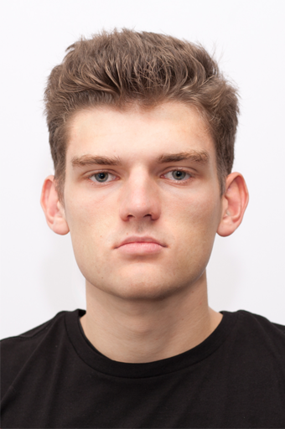
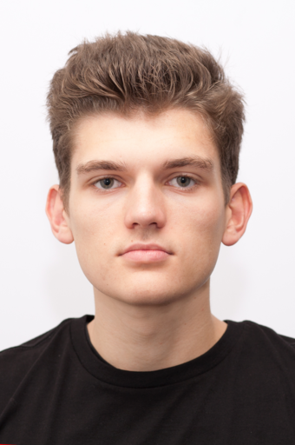
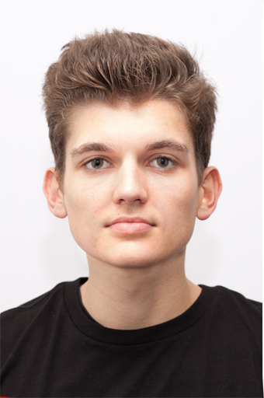
Peak-shift model
Notes:
1_Original.png

Slide 13
Peak-shift model – training
-1
+1
+0.5

Slide 14
Peak-shift model – testing
-1
+1
+0.5

Slide 15
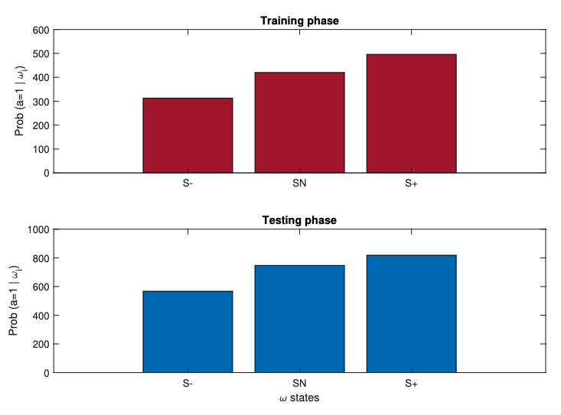
Peak-shift model – warmth domain
-1
+1
+0.5

Slide 16
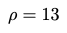
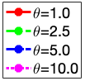
Model estimates for x=0.5 and prior = [0.33 0.33 0.33]
Shannon entropy
Nhood
Generalized entropy
Nhood

Slide 17
Model estimates for x=0.5 and prior = [0.2 0.4 0.4]
Shannon entropy
Nhood
Generalized entropy
Nhood

Slide 18
Model estimates for x=0.5 and prior = [0.8 0.1 0.1]
Shannon entropy
Nhood
Generalized entropy
Nhood

Slide 19
Model estimates for x=0.5 and prior = [0.2 0.2 0.6]
Shannon entropy
Nhood
Generalized entropy
Nhood

Slide 20
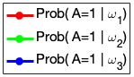
Theta=1
Shannon entropy
Nhood
Generalized entropy
Nhood

Slide 21
Theta=2.5
Shannon entropy
Nhood
Generalized entropy
Nhood

Slide 22
Theta=5
Shannon entropy
Nhood
Generalized entropy
Nhood

Slide 23
Theta=10
Shannon entropy
Nhood
Generalized entropy
Nhood

Slide 24
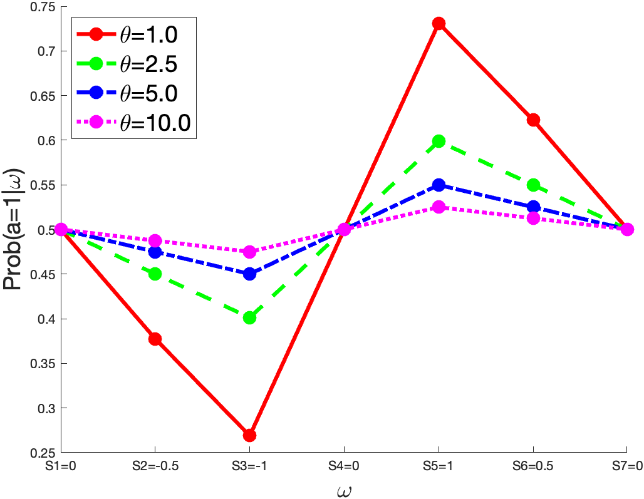
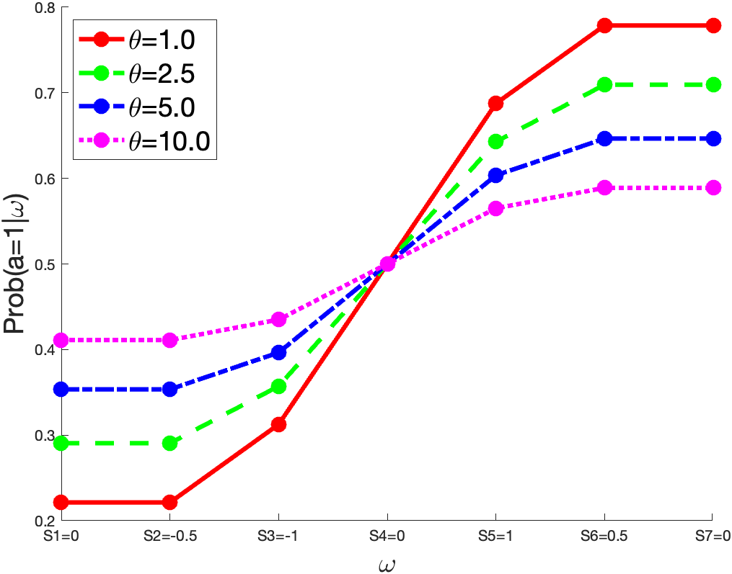
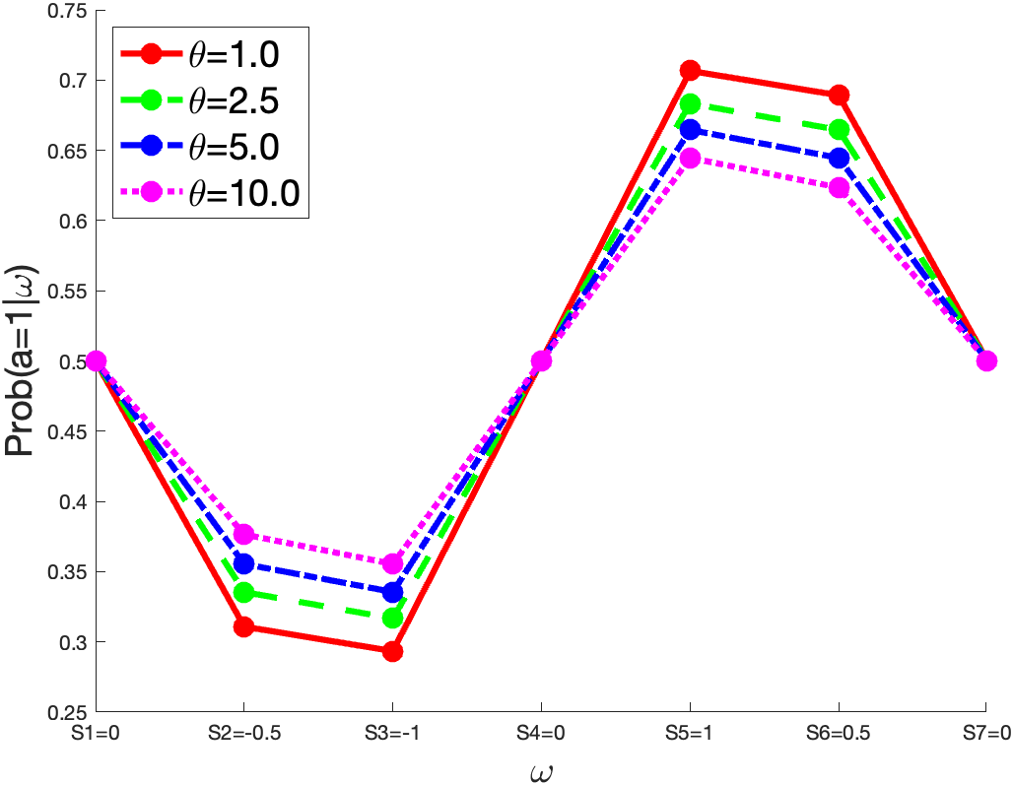
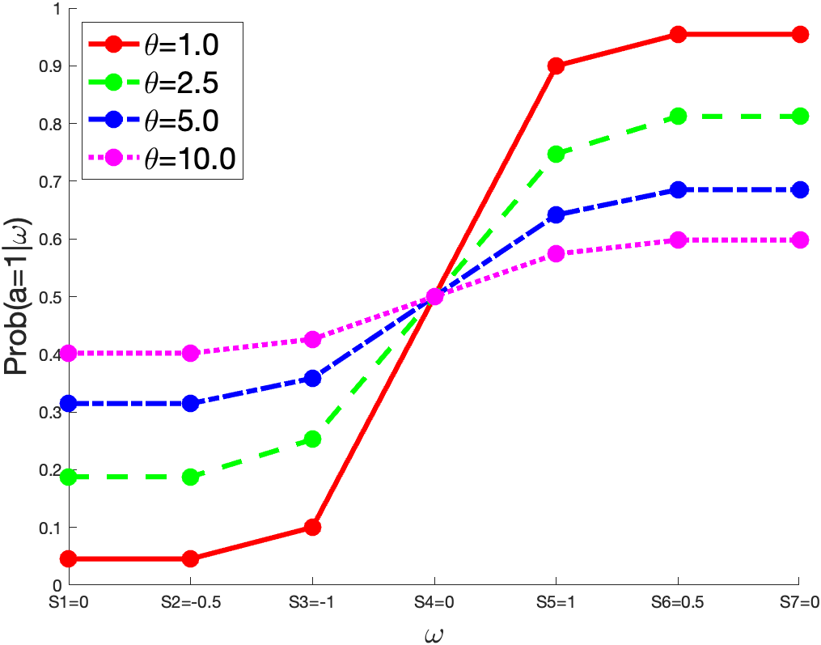
7-state case for [0; -0.5; -1; 0; +1; +0.5; 0]
Shannon entropy
Nhood
Generalized entropy
Nhood

Slide 25
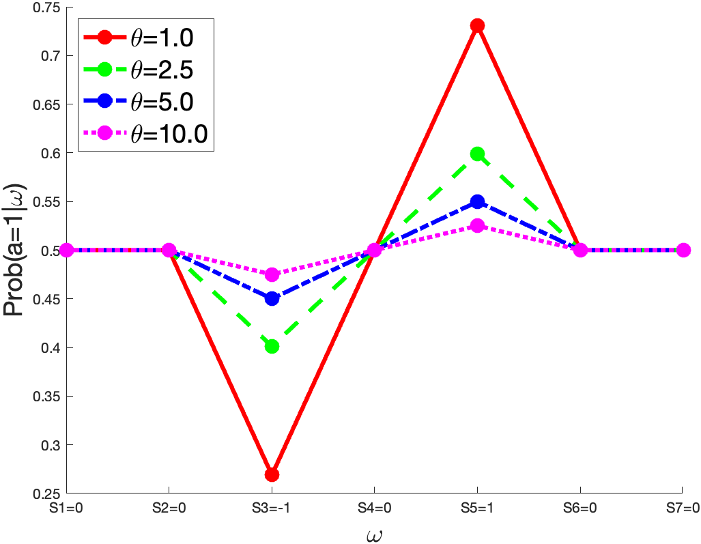
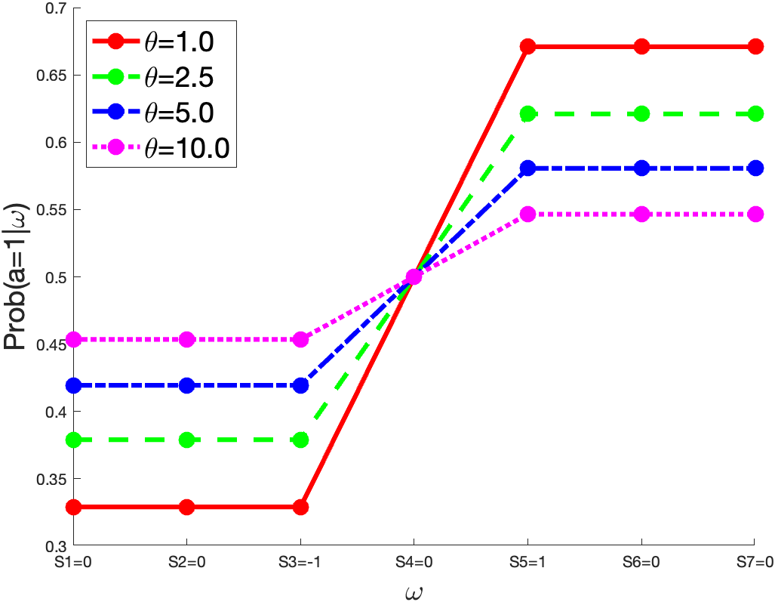
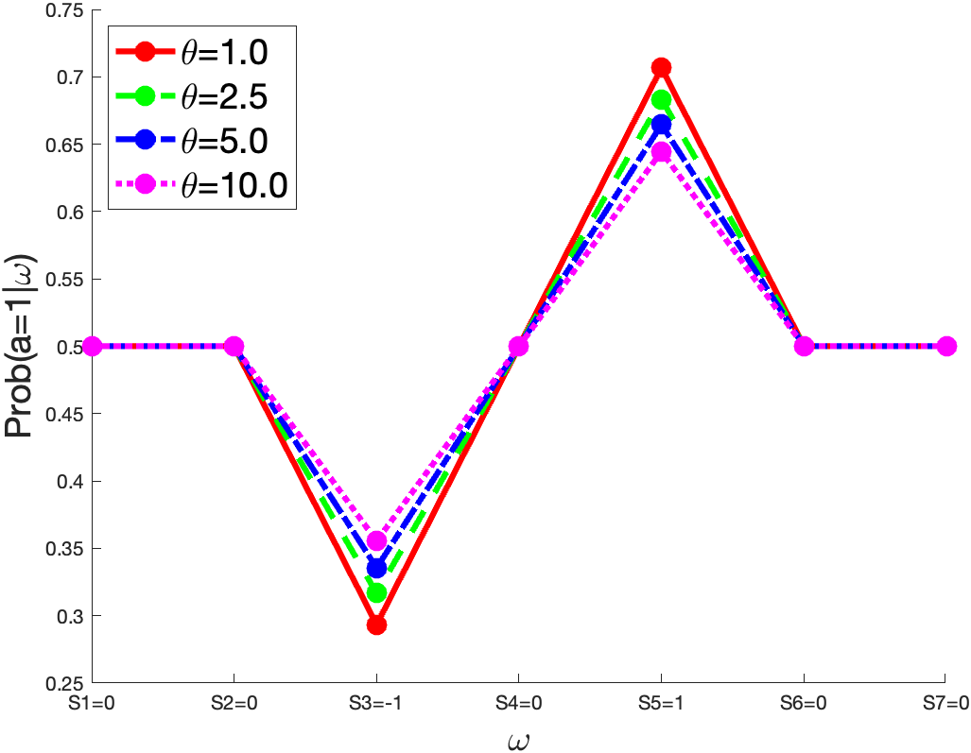
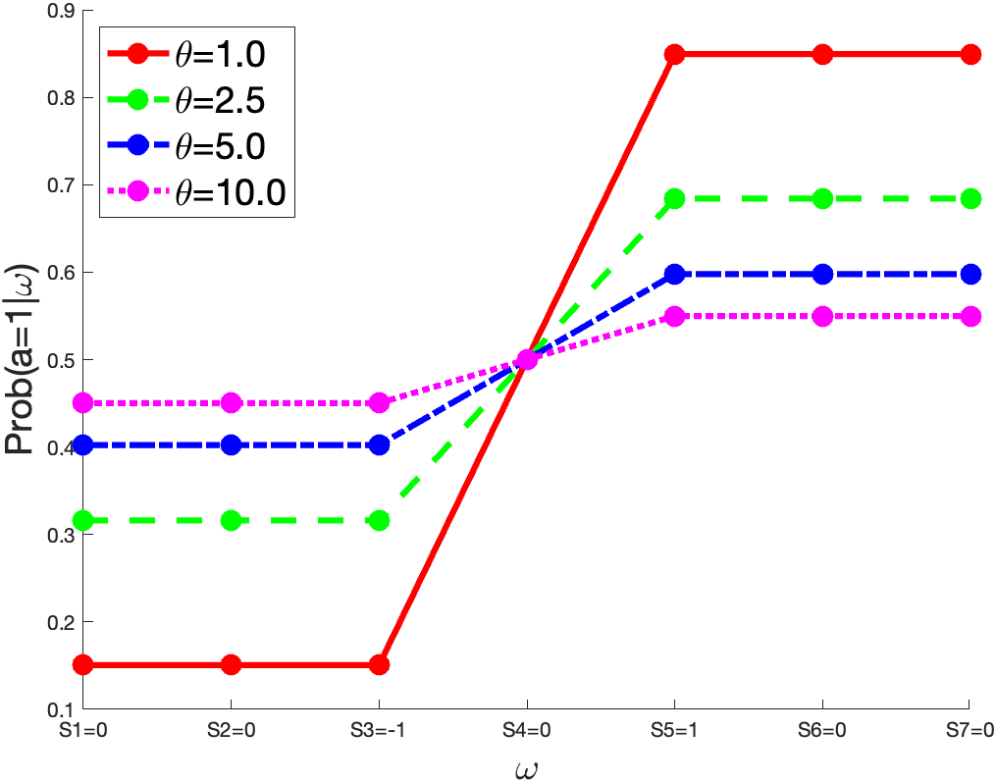
7-state case for [0; 0; -1; 0; +1; 0; 0]
Shannon entropy
Nhood
Generalized entropy
Nhood

Slide 26
Next Steps
Basel model face software + Basel face database
Morph faces on W&C spectrum
Online experiment
Eye-tracking experiment

Slide 27
Thank you

